Slide 1
Mobile Application Development
Games Academy June 2015 - Day 2
Benjamin Nitschke - Delta Engine

Slide 2
Recap of Day 1
Quick overview of platforms
Focus on Windows 8 and Windows Phone
Usage of DirectX and C++
Created Universal App to work on both devices
ARM, x86, x64
Shared code and assets
Textures, Sprite rendering, Xaml setup, Touch Input
Testing and deploying on W8 & Windows Phone
Windows Store Details

Slide 3
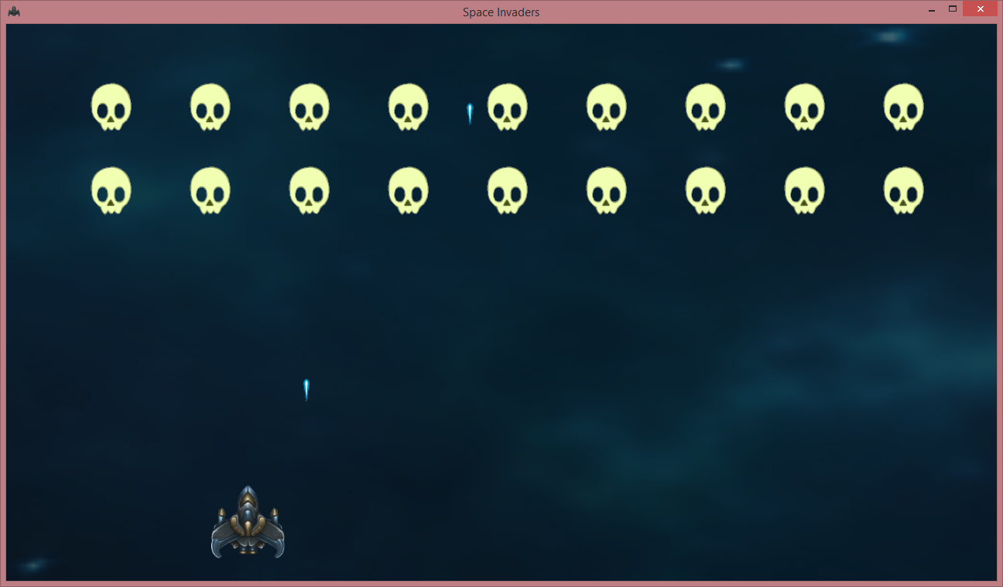
Windows 8.1 & Windows Phone 8.1

Slide 4
Time to switch platforms
Day 1: Platforms Overview
Windows, Windows 8, Windows Phone
Visual Studio: C++, C#
Day 2: Open Source Platforms
Linux, Android
Gcc: C++, Eclipse, IntelliJ: Java
Day 3: Apple Platforms
MacOS, iOS
XCode: Objective-C
Notes:
Bye bye Windows, well not really, we are lazy and will use a virtual linux on Windows via VirtualBox: https://www.virtualbox.org/

Slide 5
Installing Ubuntu
http://www.ubuntu.com/download
If you don’t have an extra PC around use
A partition or extra disk on your PC (fastest)
https://www.virtualbox.org/
or VMWare or Hyper-V or Parallels
For VirtualBox use 32-bit ISOs (we also don’t want to spend too much memory on this, 1GB is okay)
Download is 1GB, installation also takes a while!

Slide 6
Programming languages
Unix is the C-Platform!
A lot of other languages & tools are available
However no Visual Studio :(
As a developer you have to know the command line
If you have used cgywin before, its easier
Quick tour of commands
sudo, ls, mount, mkdir, rm, file, kill, pkill, time, find ...
Notes:
Good overview table of commands at bottom of this page: https://en.wikipedia.org/wiki/Sudo

Slide 7
Let’s compile with gcc
All linux distributions have gcc (for C) available
To install g++ (for C++) use: sudo apt-get install g++
Create a simple text file, compile and run it
cat > test.cpp
#include <stdio.h>
int main() { printf(“Hi there\n”); } (Ctrl+D to close file)
g++ test.cpp -o test
./test
Notes:
http://www.network-theory.co.uk/docs/gccintro/gccintro_9.html
Also see my C++ course for a text adventure: https://github.com/BenjaminNitschke/CppCourse/tree/master/Day1

Slide 8

Android
Notes:
Android may be based on Linux, but it’s not based on the type of Linux system you may have used on your PC.
http://www.howtogeek.com/189036/android-is-based-on-linux-but-what-does-that-mean/

Slide 9
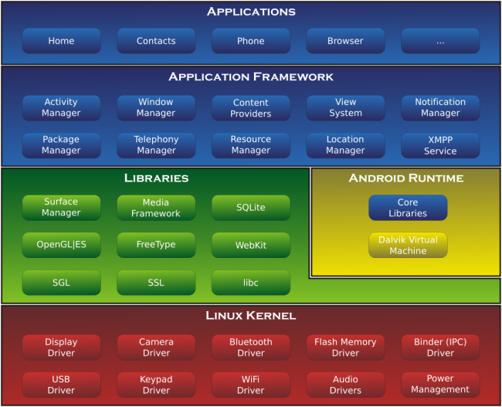
Linux Kernel in Android
Notes:
Android may be based on Linux, but it’s not based on the type of Linux system you may have used on your PC.
http://www.howtogeek.com/189036/android-is-based-on-linux-but-what-does-that-mean/

Slide 10
Android Studio
Official Android IDE
Up to date SDK, tools and emulators
Eclipse is the standard Java IDE
Android Development in the past used this
IntelliJ is another good Java IDE
Android IDE is based on the Community Edition
Workflow is simpler (no workspaces, JUnit, signing)
Works on: Windows, MacOS and Linux
Notes:
Since we going the recommended route, Android Studio it is: http://developer.android.com/sdk/index.html

Slide 11
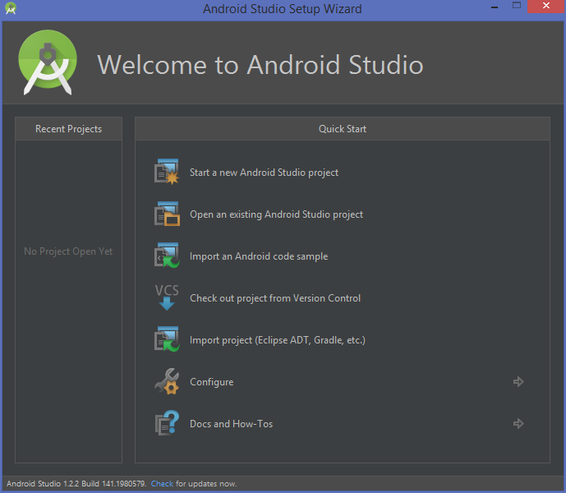
Android Studio
Notes:
Create new Android Studio project

Slide 12
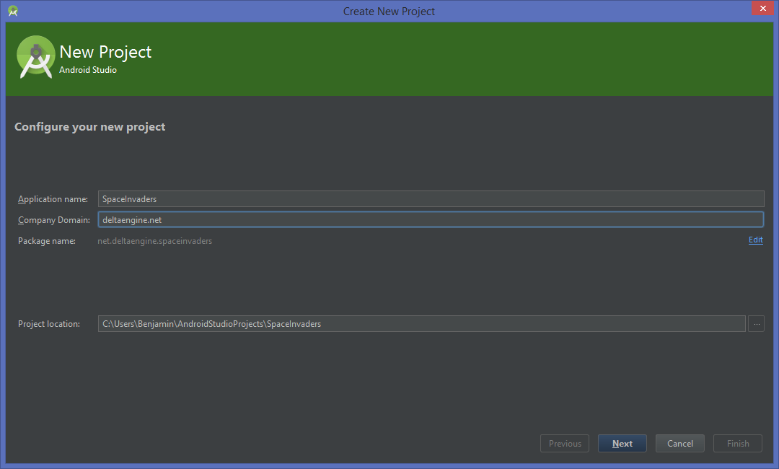
Create new SpaceInvaders project
Notes:
Show each of the options, each of these options are the same for C# Store Apps as well.

Slide 13
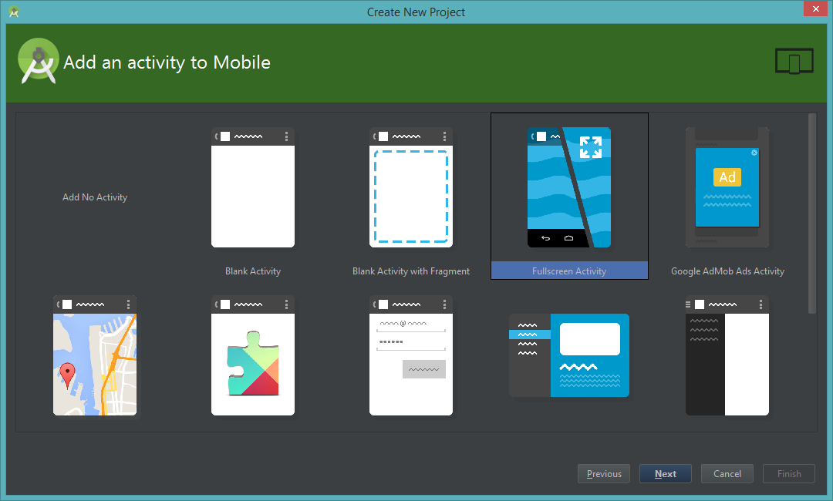
Pick Fullscreen Activity

Slide 14
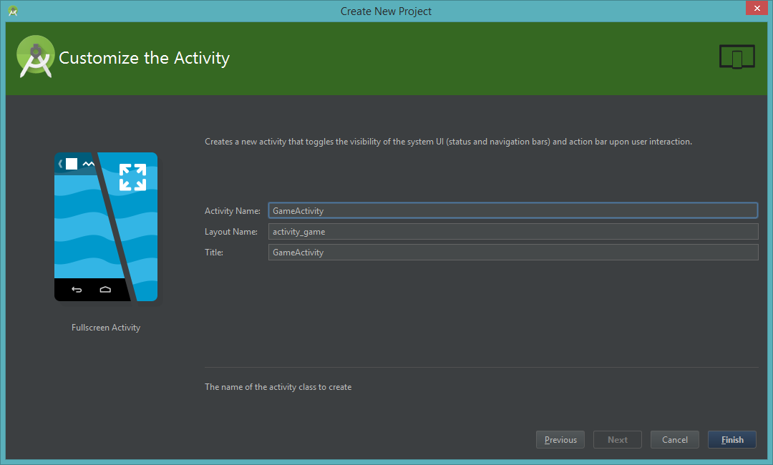
Finish wizard with an Activity Name

Slide 15
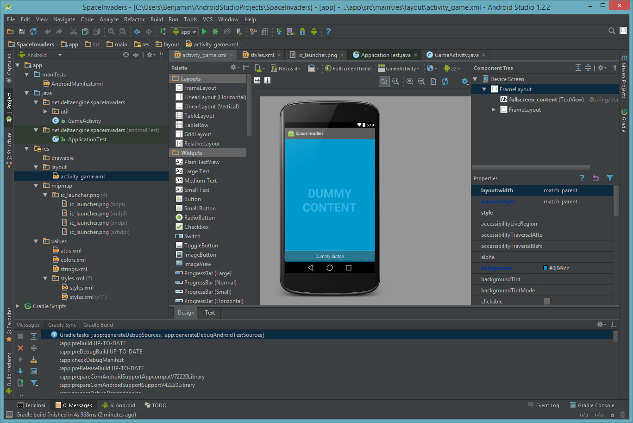
Deploy to emulator and device
Notes:
Explore the created project and test it on emulator and device first!
If required setup

Slide 16
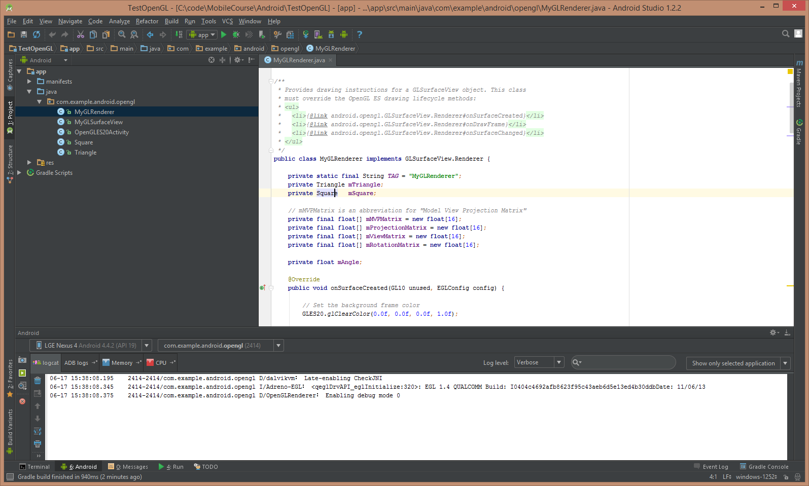
OpenGL ES 2.0
Notes:
After testing and confirming the TestOpenGL app works in the emulator and on the device, go back to SpaceInvaders and follow this tutorial: http://developer.android.com/training/graphics/opengl/environment.html

Slide 17
Live Coding
Creation of the SpaceInvaders Game
Based on the same code as yesterday
https://github.com/BenjaminNitschke/CppCourse/Day2
First steps
Get OpenGL renderer working
Show background sprite (same as before via ES11)
Optional for ES20: Write 2D texturing shader
Convert all C++ classes and game logic to Java
Notes:
Since we will be coding together now slides do not make so much sense, most things need to be explained and everyone should be typing his game. Links to the existing TextAdventure code will be given in the next slide, which we will only look at by the end of today.

Slide 18
GameActivity sets the SurfaceView
package net.deltaengine.spaceinvaders;
import android.app.Activity;
import android.opengl.GLSurfaceView;
import android.os.Bundle;
public class GameActivity extends Activity {
@Override
public void onCreate(Bundle savedInstanceState) {
super.onCreate(savedInstanceState);
view = new SpaceInvadersSurfaceView(this);
setContentView(view);
}
private GLSurfaceView view;
}
Notes:
Since we will be coding together now slides do not make so much sense, most things need to be explained and everyone should be typing his game. Links to the existing TextAdventure code will be given in the next slide, which we will only look at by the end of today.

Slide 19
SpaceInvadersSurfaceView
package net.deltaengine.spaceinvaders;
import android.content.Context;
import android.opengl.GLSurfaceView;
public class SpaceInvadersSurfaceView extends GLSurfaceView {
public SpaceInvadersSurfaceView(Context context){
super(context);
setEGLContextClientVersion(2);
renderer = new SpaceInvadersRenderer();
setRenderer(renderer);
}
private final SpaceInvadersRenderer renderer;
}
Notes:
Since we will be coding together now slides do not make so much sense, most things need to be explained and everyone should be typing his game. Links to the existing TextAdventure code will be given in the next slide, which we will only look at by the end of today.

Slide 20
SpaceInvadersRenderer
package net.deltaengine.spaceinvaders;
import ...
public class SpaceInvadersRenderer implements GLSurfaceView.Renderer {
public void onSurfaceCreated(GL10 unused, EGLConfig config) {
GLES20.glClearColor(0.0f, 0.0f, 0.0f, 1.0f);
}
public void onDrawFrame(GL10 unused) {
GLES20.glClear(GLES20.GL_COLOR_BUFFER_BIT);
}
public void onSurfaceChanged(GL10 unused, int width, int height) {
GLES20.glViewport(0, 0, width, height);
}
}
Notes:
Since we will be coding together now slides do not make so much sense, most things need to be explained and everyone should be typing his game. Links to the existing TextAdventure code will be given in the next slide, which we will only look at by the end of today.

Slide 21
Create Sprite class
Copy C++ Sprite class
Replace with Java code
Texture class uses OpenGL int handle again
Math functions are in Math class
Drawing is pretty much the same in ES 1.1
Except we cannot use GL immediate mode
Instead we need to create vertex buffers or arrays

Slide 22
Texture class
public Texture(AssetManager assets, String filename){
int[] handles = new int[1];
GLES11.glGenTextures(1, handles, 0);
handle = handles[0];
GLES11.glBindTexture(GLES11.GL_TEXTURE_2D, handle);
GLES11.glTexParameterf(GLES11.GL_TEXTURE_2D, GLES11.GL_TEXTURE_MIN_FILTER, GLES11.GL_LINEAR);
GLES11.glTexParameterf(GLES11.GL_TEXTURE_2D, GLES11.GL_TEXTURE_MAG_FILTER, GLES11.GL_LINEAR);
try {
InputStream stream = assets.open(filename);
Bitmap bitmap = BitmapFactory.decodeStream(stream);
width = bitmap.getWidth();
height = bitmap.getHeight();
GLUtils.texImage2D(GLES11.GL_TEXTURE_2D, 0, bitmap, 0);
bitmap.recycle();
stream.close();
} catch (final IOException e) {
e.printStackTrace();
}
}
private final int handle;
private int width;
private int height;
Notes:
Since we will be coding together now slides do not make so much sense, most things need to be explained and everyone should be typing his game. Links to the existing TextAdventure code will be given in the next slide, which we will only look at by the end of today.

Slide 23
Sprite class
public Sprite(Texture texture, float initialX,
float initialY, float width, float height){
this.texture = texture; this.initialX = initialX;
this.initialY = initialY; this.width = width;
this.height = height; CreateBuffers();
}
private final Texture texture;
private final float initialX, initialY, width, height;
public void CreateBuffers()
{
ByteBuffer vbb = ByteBuffer.allocateDirect( 4 * 3 * 4 );
vbb.order( ByteOrder.nativeOrder() );
vertexBuffer = vbb.asFloatBuffer();
vertexBuffer.put(new float[] {
-1, 1, 0, -1, -1, 0, 1, -1, 0, 1, 1, 0 });
ByteBuffer ibb = ByteBuffer.allocateDirect( 2 * 3 * 2 );
ibb.order( ByteOrder.nativeOrder() );
indexBuffer = ibb.asShortBuffer();
indexBuffer.put(new short[] { 0, 1, 2, 0, 2, 3 });
ByteBuffer tbb = ByteBuffer.allocateDirect( 4 * 2 * 4 );
tbb.order( ByteOrder.nativeOrder() );
uvBuffer = tbb.asFloatBuffer();
uvBuffer.put(new float[] {
0.0f, 0.0f, 0.0f, 1.0f, 1.0f, 1.0f, 1.0f, 0.0f });
}
public void Draw(float x, float y) {
GLES11.glBindTexture(GLES11.GL_TEXTURE_2D,
texture.GetHandle());
GLES11.glEnable(GLES11.GL_TEXTURE_2D);
GLES11.glEnableClientState(GLES11.GL_VERTEX_ARRAY);
GLES11.glEnableClientState(
GLES11.GL_TEXTURE_COORD_ARRAY);
GLES11.glTexCoordPointer(2, GLES11.GL_FLOAT, 0,
uvBuffer);
vertexBuffer.position(0);
vertexBuffer.put(new float[]{ // top left
initialX + x - width, initialY + y + height, 0,
// bottom left
initialX + x - width, initialY + y - height, 0,
// bottom right
initialX + x + width, initialY + y - height, 0,
//top right
initialX + x + width, initialY + y + height, 0
});
vertexBuffer.position(0);
GLES11.glVertexPointer(3, GLES11.GL_FLOAT, 0,
vertexBuffer);
GLES11.glDrawElements(GLES11.GL_TRIANGLES, 2 * 3,
GLES11.GL_UNSIGNED_SHORT, indexBuffer);
}
Notes:
Since we will be coding together now slides do not make so much sense, most things need to be explained and everyone should be typing his game. Links to the existing TextAdventure code will be given in the next slide, which we will only look at by the end of today.

Slide 24
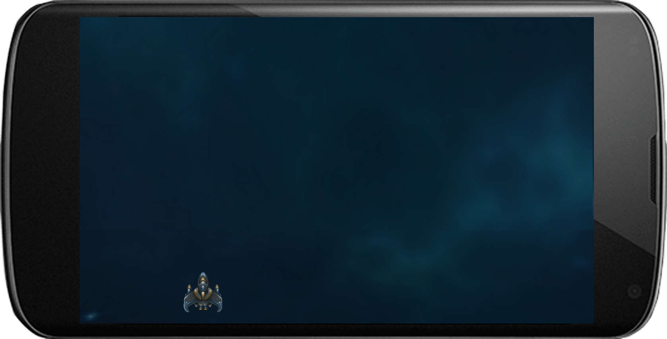
Background and Player Ship

Slide 25
Background and Player Ship
public class SpaceInvadersSurfaceView extends GLSurfaceView { ...
@Override
public boolean onTouchEvent(MotionEvent e) {
renderer.shipPosition = -1 + 2 * (e.getX() / renderer.screenWidth);
return true;
}
}
public class SpaceInvadersRenderer implements GLSurfaceView.Renderer { ...
Sprite ship;
float shipPosition = 0;
public void onDrawFrame(GL10 gl) {
gl.glClear(gl.GL_COLOR_BUFFER_BIT);
background.Draw();
ship.Draw(shipPosition);
}
public void onSurfaceChanged(GL10 gl, int width, int height) {
gl.glViewport(0, 0, width, height);
screenWidth = width;
}
public int screenWidth;
Notes:
Handling touch input (similar to Windows 8 and Windows Phone via an event)

Slide 26
Android Play Store Tour
To release the finished game in the Play Store
Google Account is needed
Sign Up in the Google Play Developer Console
https://play.google.com/apps/publish/signup/
Pay $25 Registration Fee
Create certificate and sign your app
Upload app to Store, set price, etc.
For testing using Debug Certificate is totally okay, you can even give it to other developers as long as their unlock their phones.
Notes:
https://support.google.com/googleplay/android-developer/answer/113469?hl=en

Slide 27
Questions?
All code and these slides are available at:
https://github.com/BenjaminNitschke/MobileCourse

Slide 28
Links
https://www.virtualbox.org/
http://www.ubuntu.com/download
http://developer.android.com/index.html
http://developer.android.com/guide/index.html
http://developer.android.com/tools/studio/index.html
http://developer.android.com/training/graphics/opengl/index.html
http://developer.android.com/distribute/tools/launch-checklist.html
https://play.google.com/apps/publish/signup/
https://support.google.com/googleplay/android-developer/answer/113469?hl=en

